Slide 1



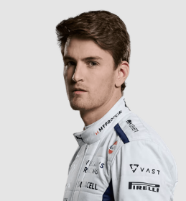
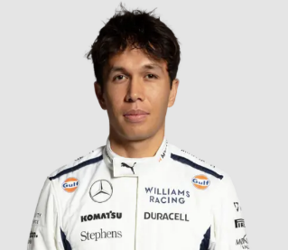

UBS
BAHRAIN
Formula 1 BAHRAIN GRAND PRIX
GRAND PRIX
Williams Grand Prix Engineering Limited
MSDM5005 Group 4
Sakheer الصخير‎
2 MARCH 2024

Slide 2
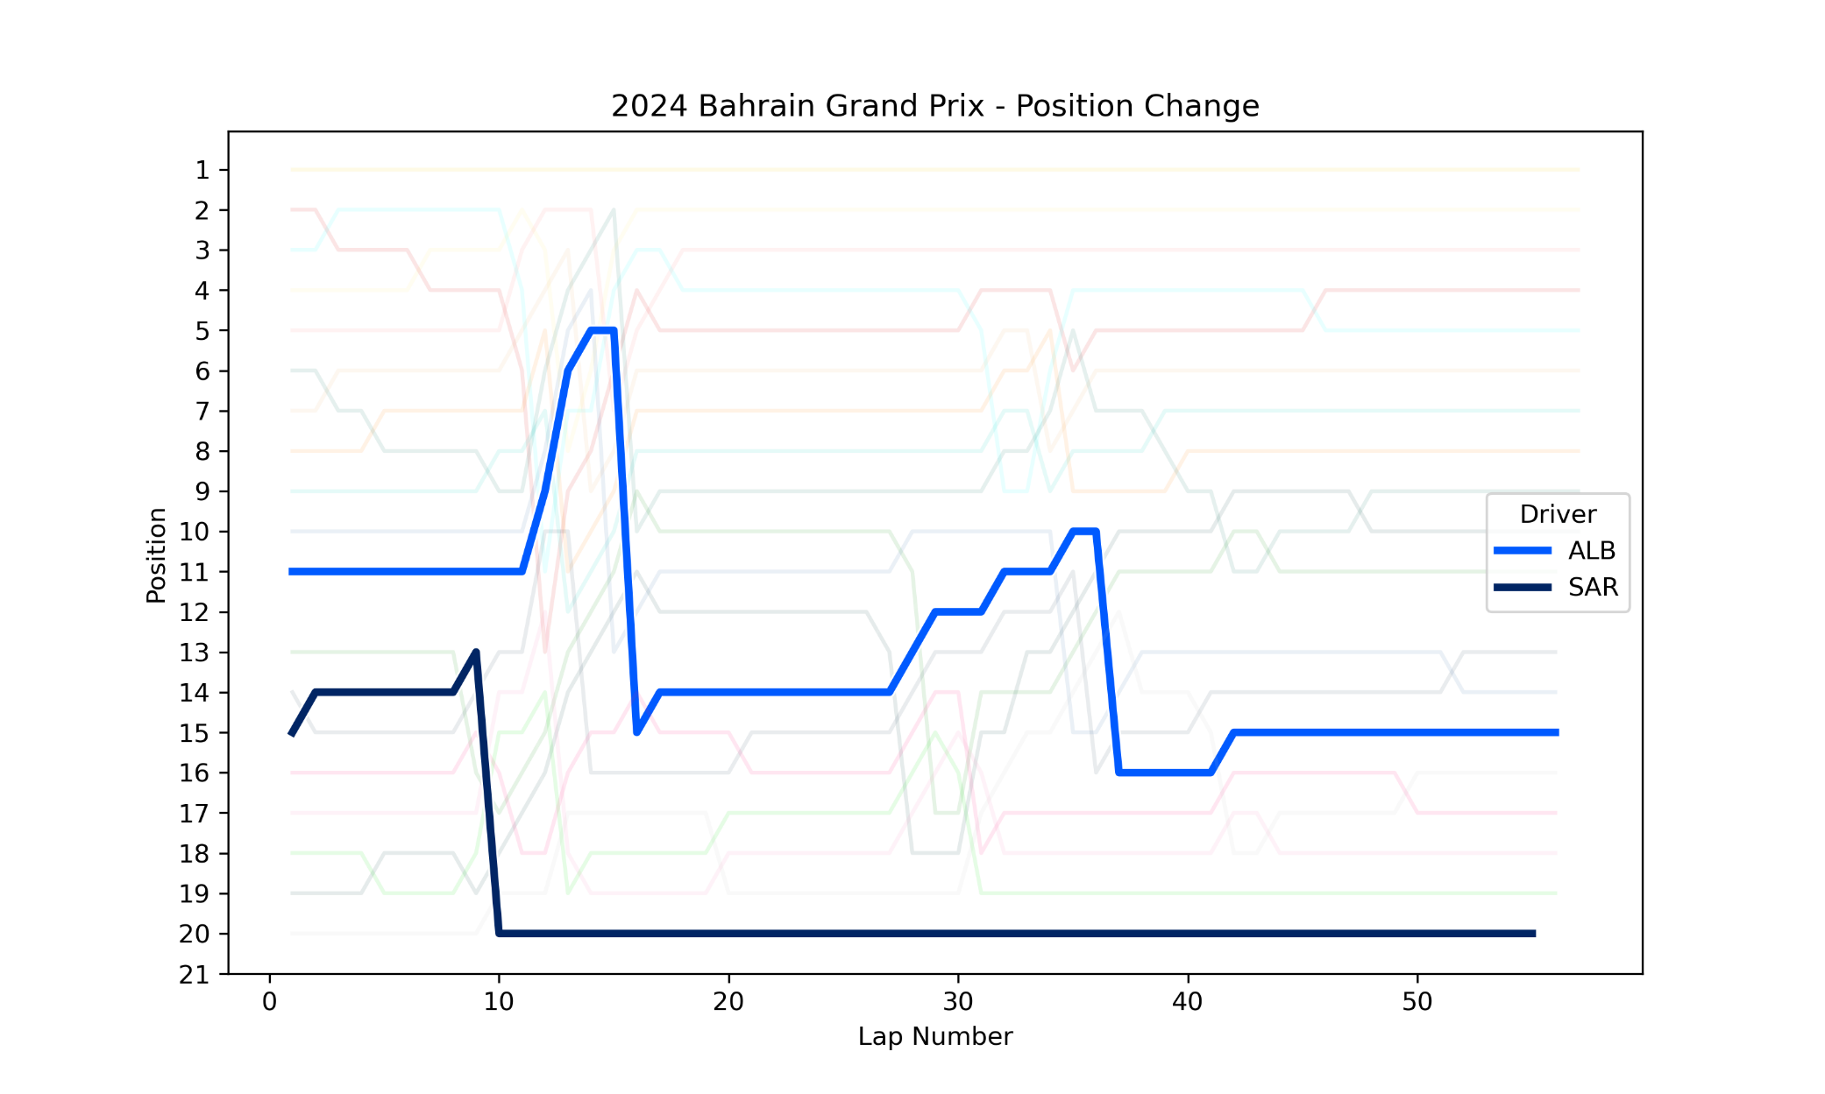
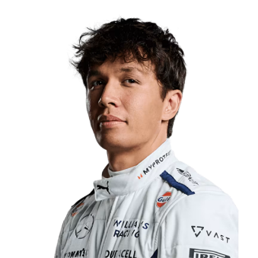
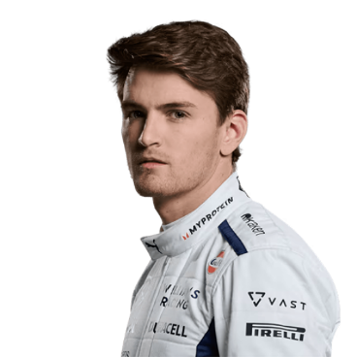
UBS
Player Performance
BAHRAIN
GRAND PRIX
ranking list
2 MARCH 2024
Alexander Albon
Qualifying Ranking: 13
Race Ranking: 15
56 Laps, + 1 lap
Logan Sargeant
Qualifying Ranking: 18
Race Ranking: 20
55 Laps, + 2 lap

Slide 3
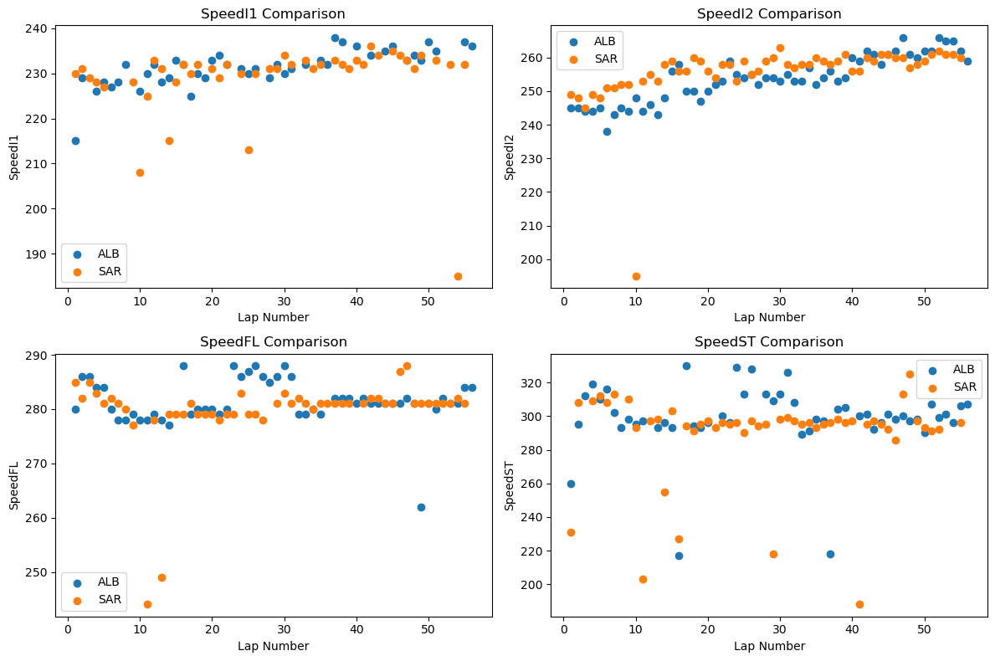
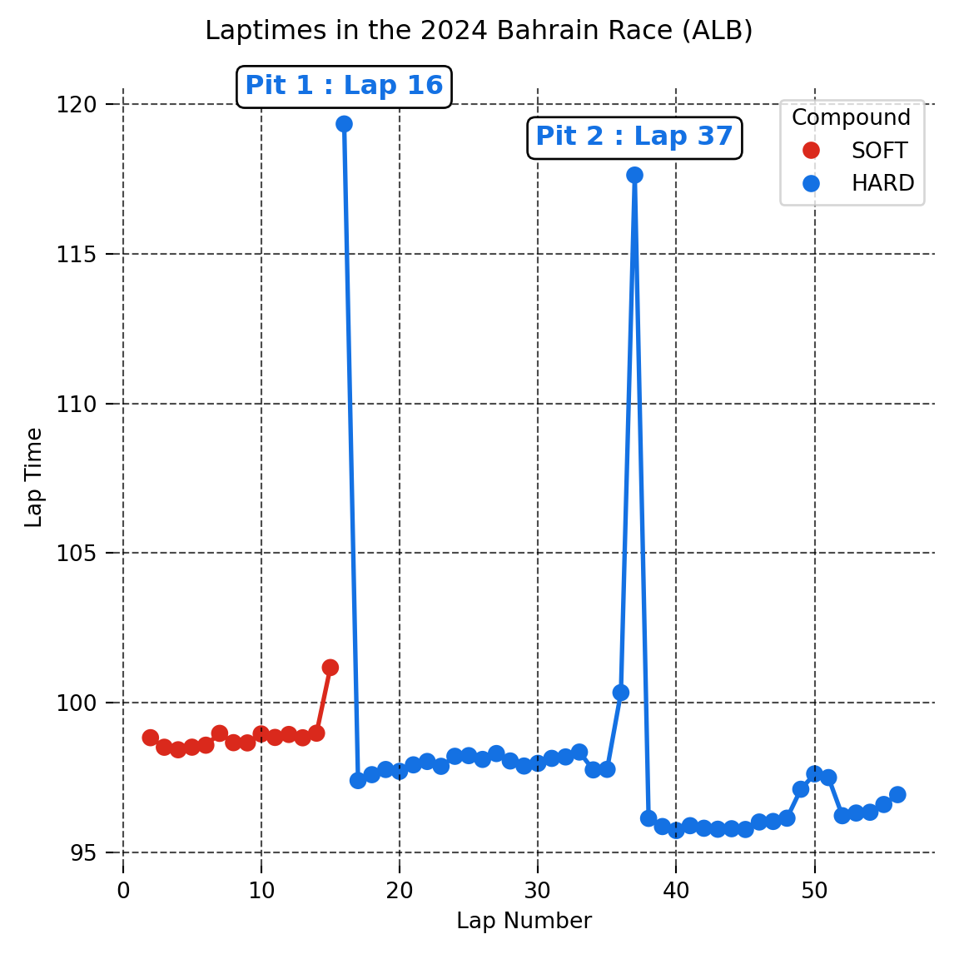
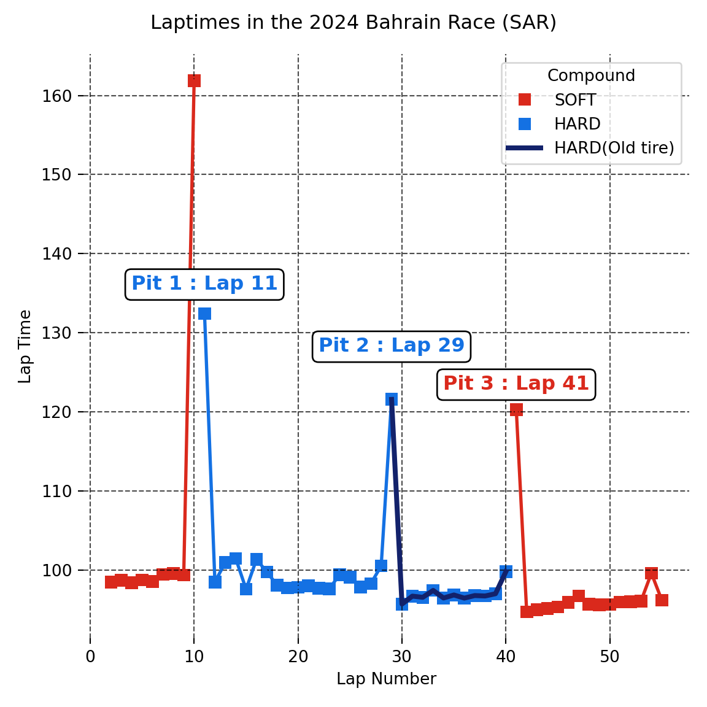
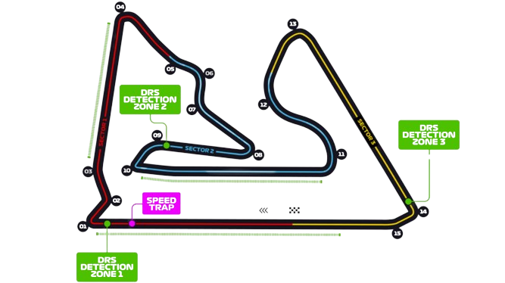
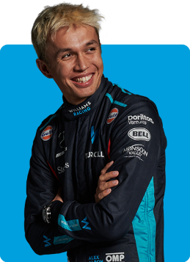








UBS
Player Performance
BAHRAIN
GRAND PRIX
Tire strategy
2 MARCH 2024
Old tire

Slide 4
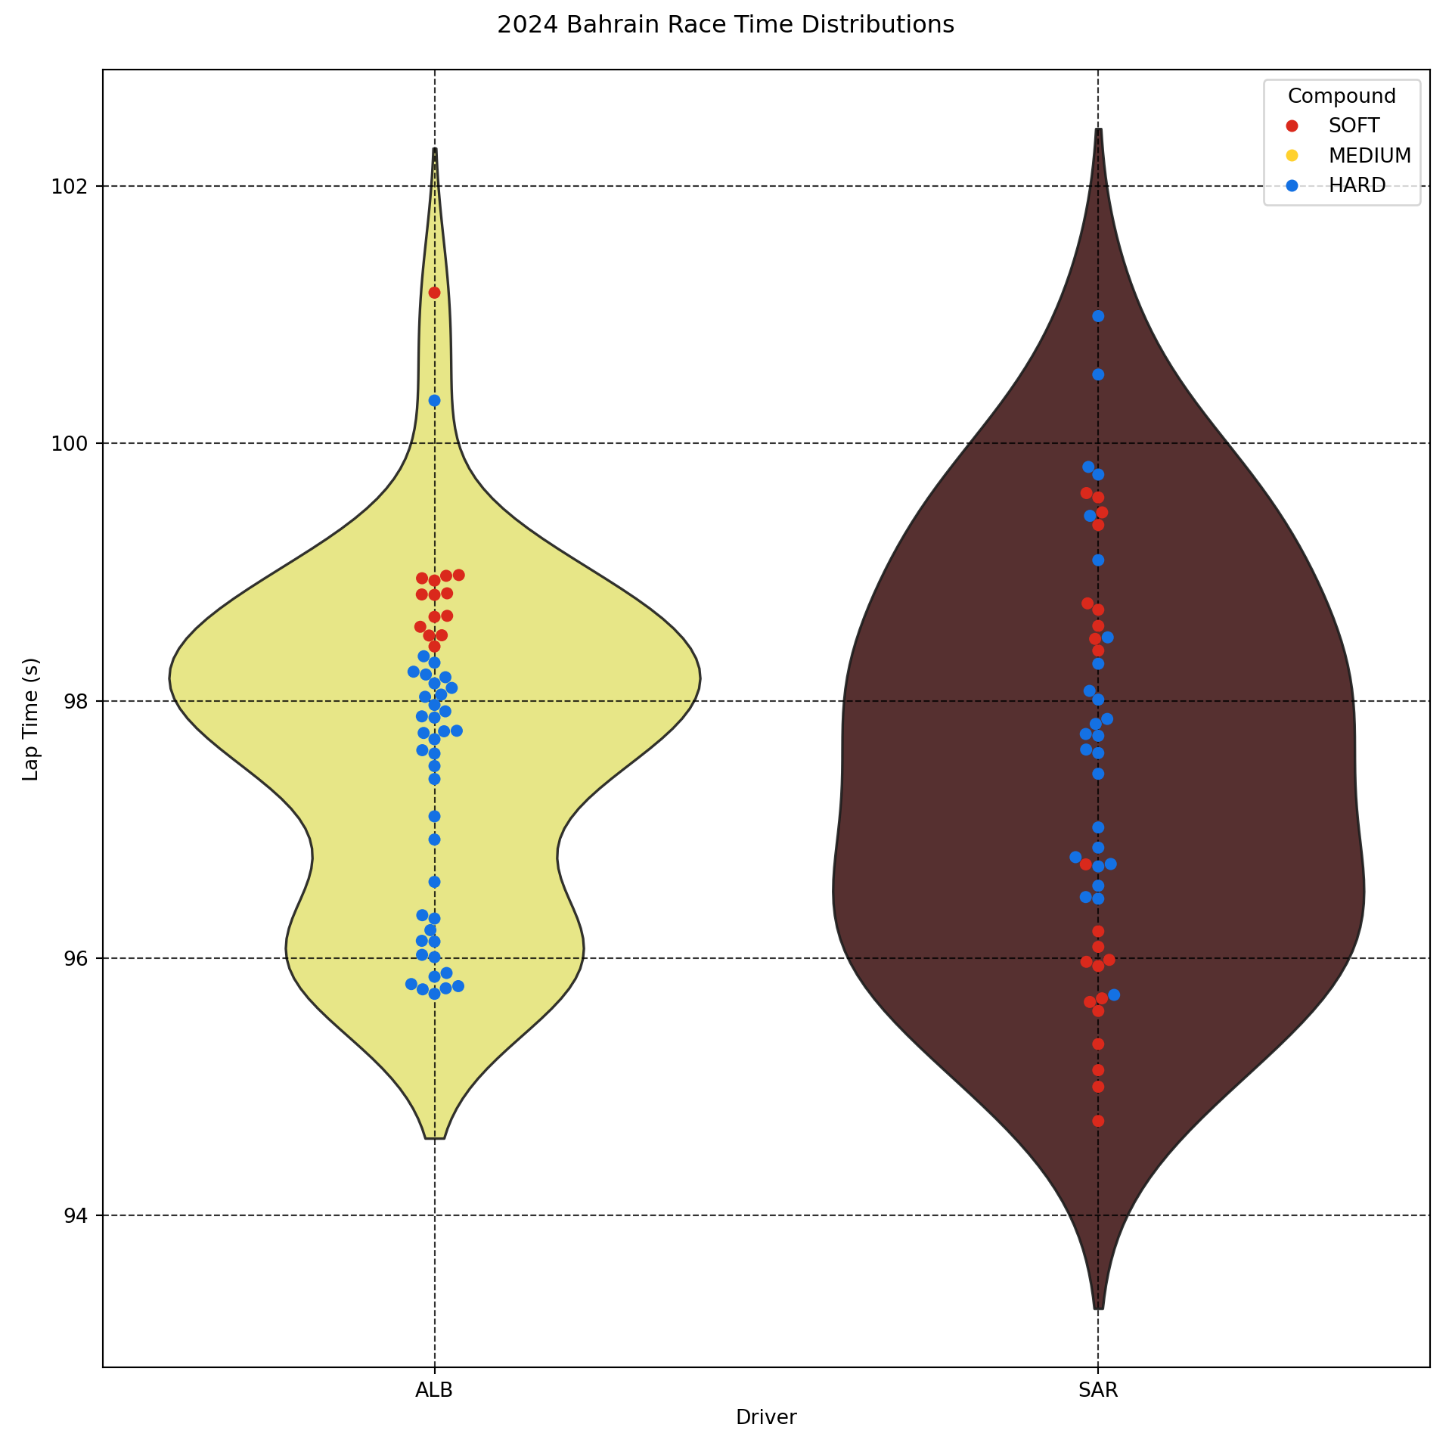
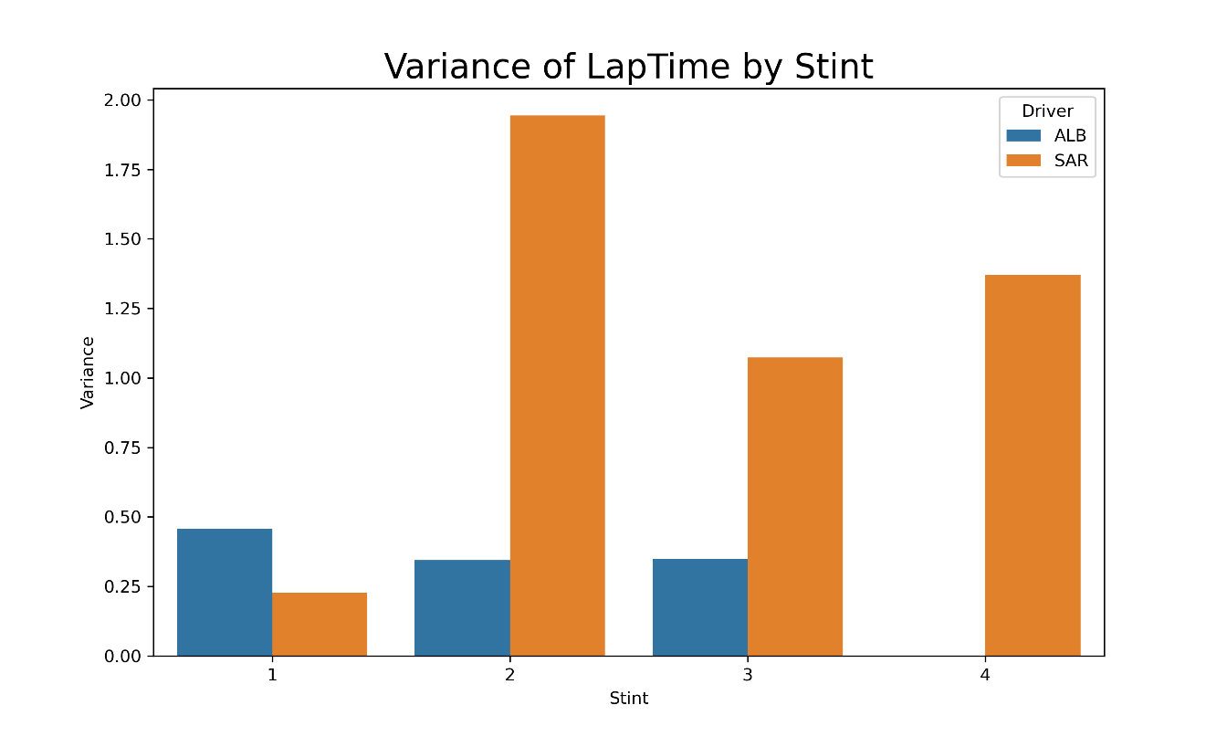
UBS
Player Performance
BAHRAIN
GRAND PRIX
STABILITY comparison
2 MARCH 2024
Albon keeps high stability in all three stints
Sargeant is unstable in the latter three stints, especially the second stint

Slide 5
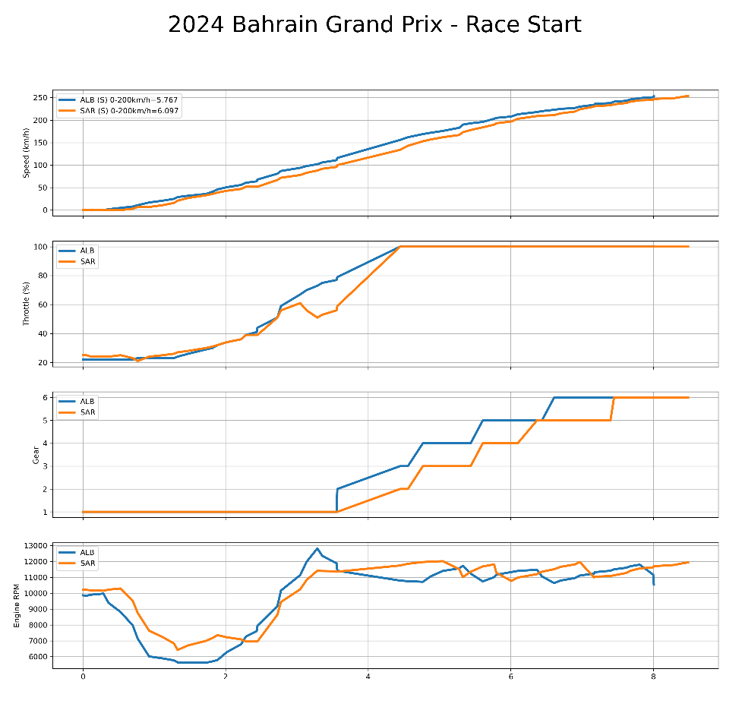
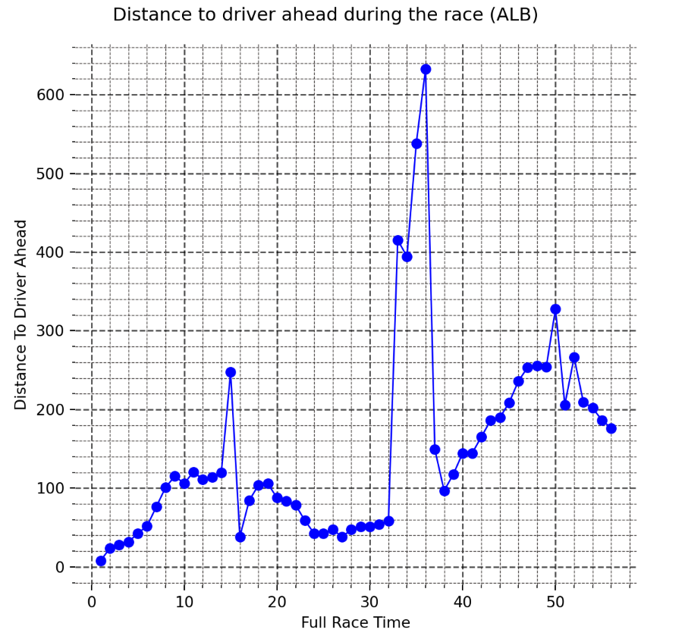
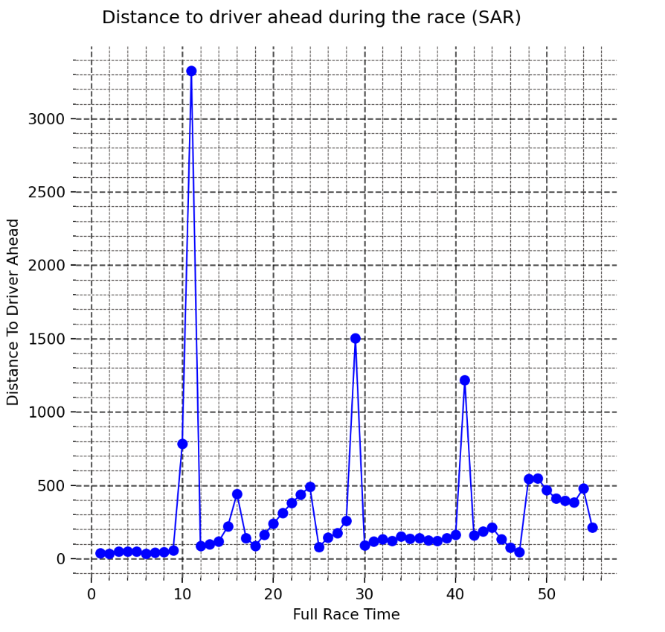
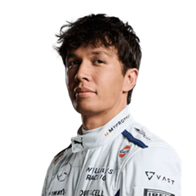
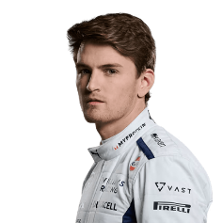
UBS
Player Performance
BAHRAIN
GRAND PRIX
Gap with front cars; Driving tech & strategy comparison
2 MARCH 2024
For each lap, we mark the distance between the two drivers and the car in front
Compared with Albon, the distance between Sargeant and the front car is larger, and the change of distance between Sargeant and the front car is more unstable.
In race start,Albon got off to a slightly faster start than Sergeant, shifting gears more quickly and slowing down the throttle and engine before leveling off.

Slide 6
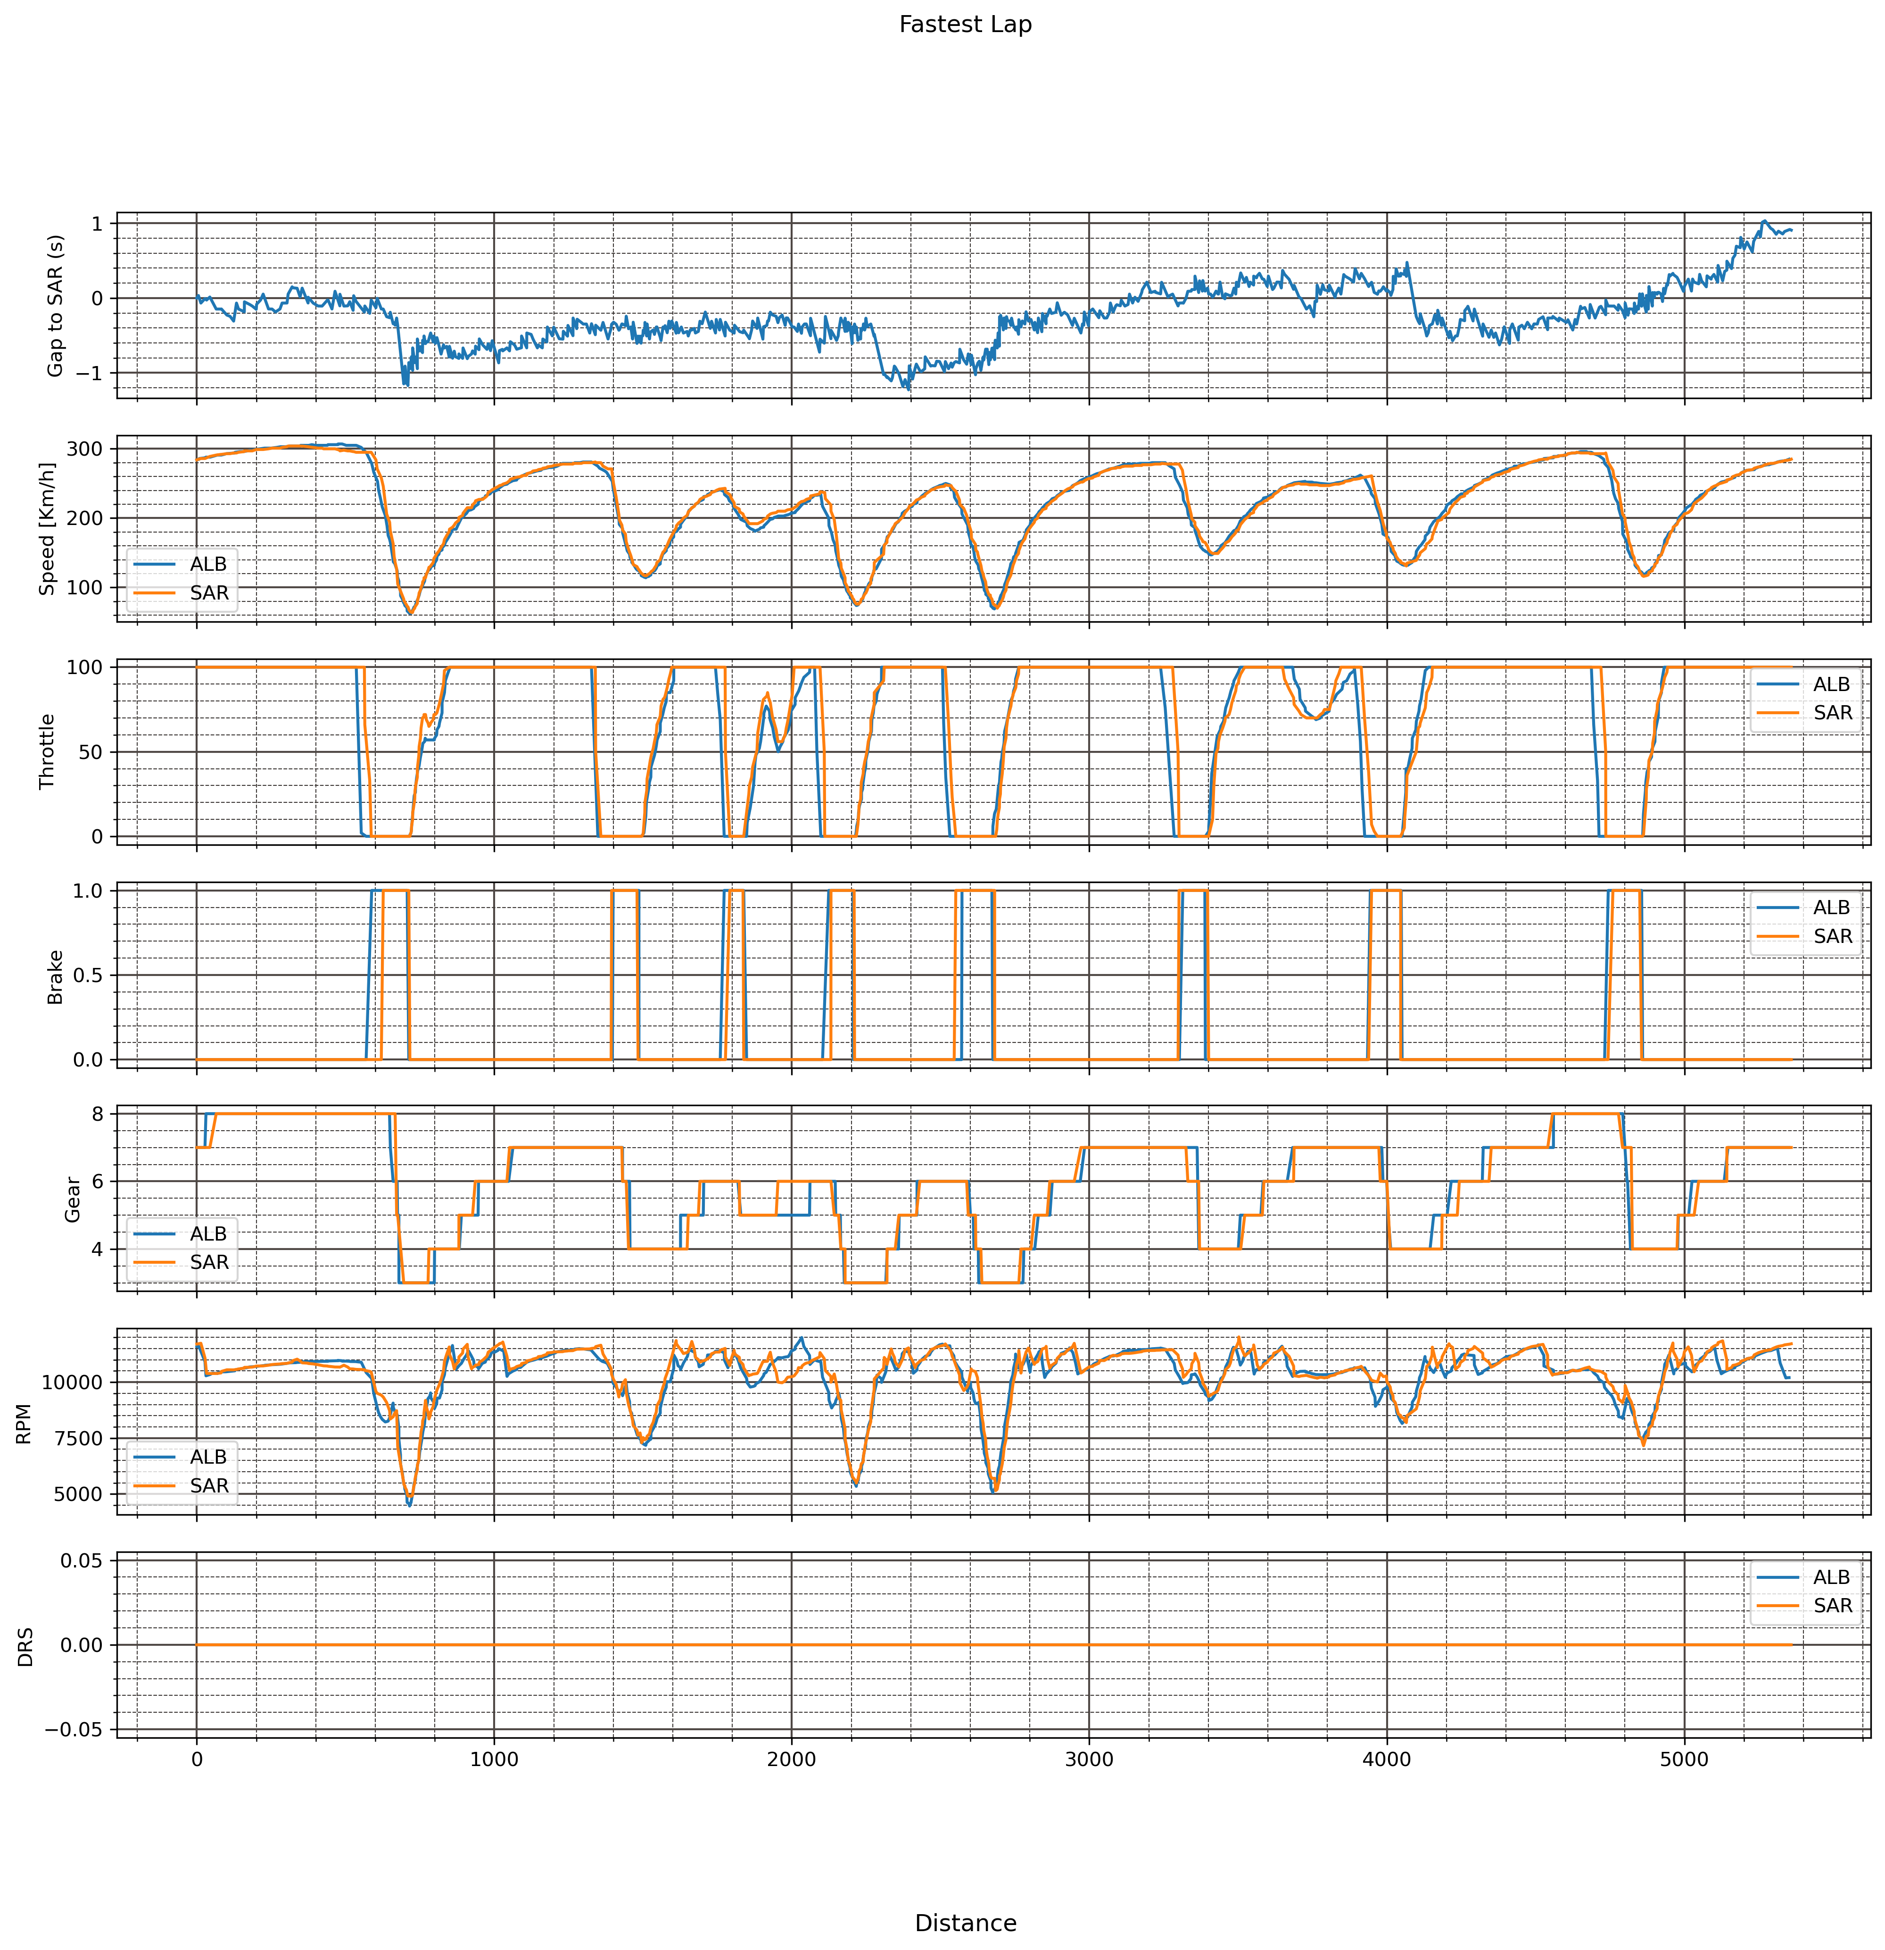
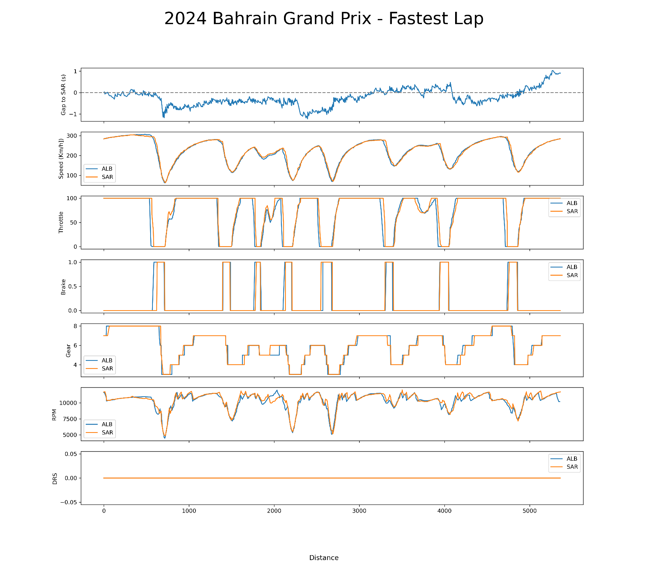
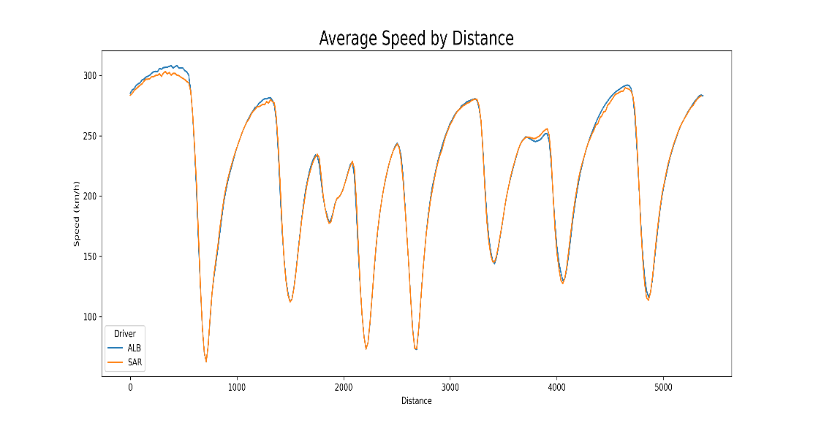
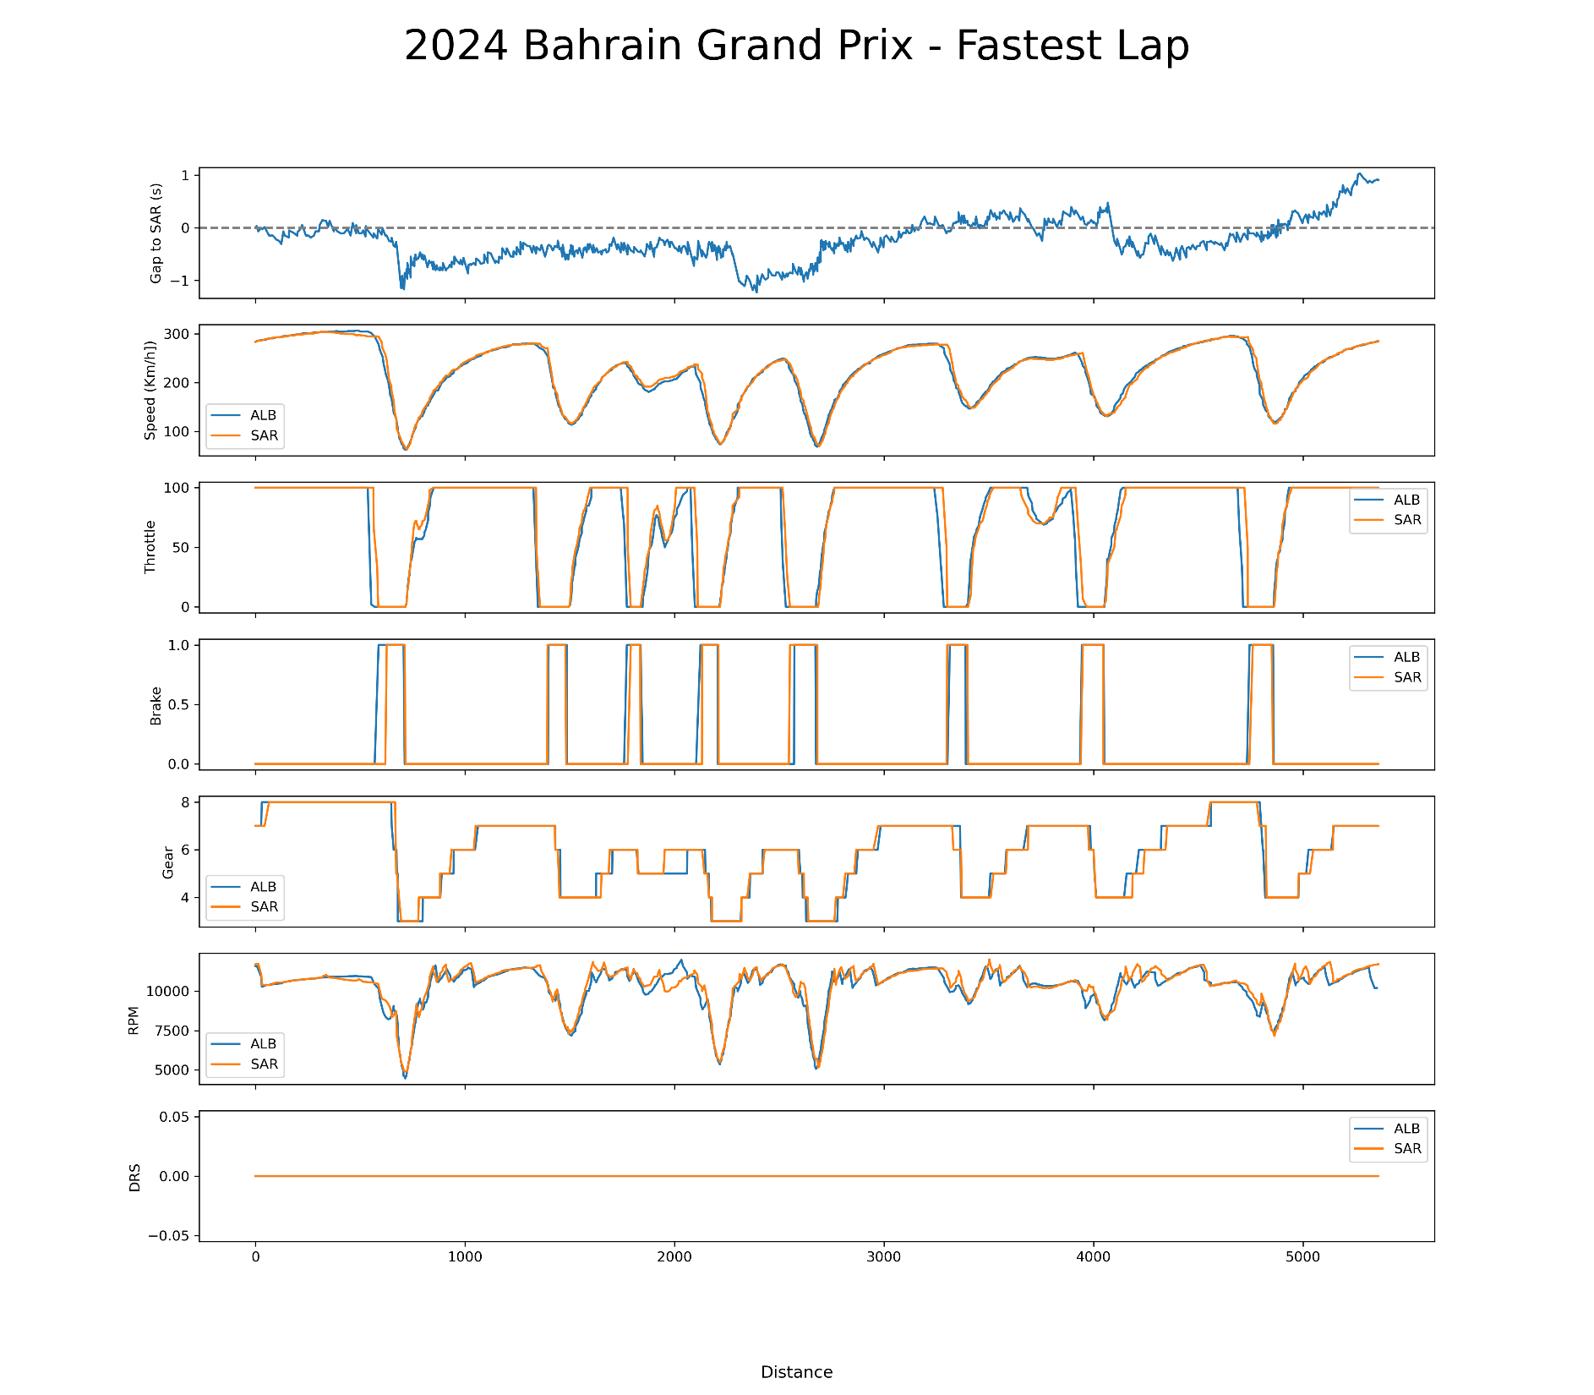
UBS
Player Performance
BAHRAIN
GRAND PRIX
Driving tech & strategy comparison
2 MARCH 2024
We collected data on the fastest laps run by the two drivers and made a technical comparison on Gap; Speed; Throttle, Brake, Gear, RPM, as well as DRS with distance

Slide 7
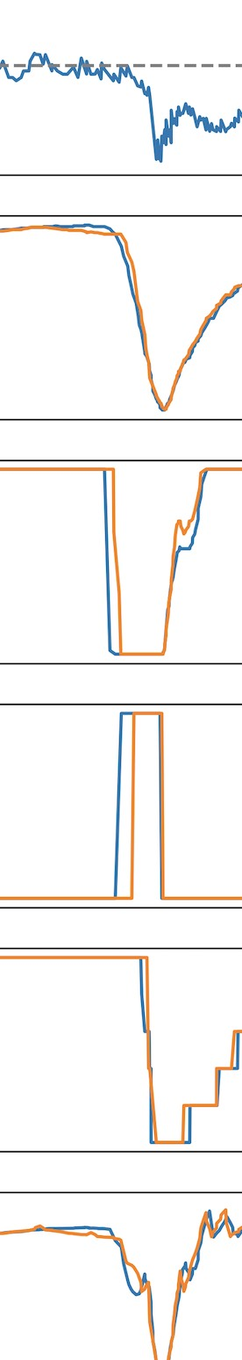
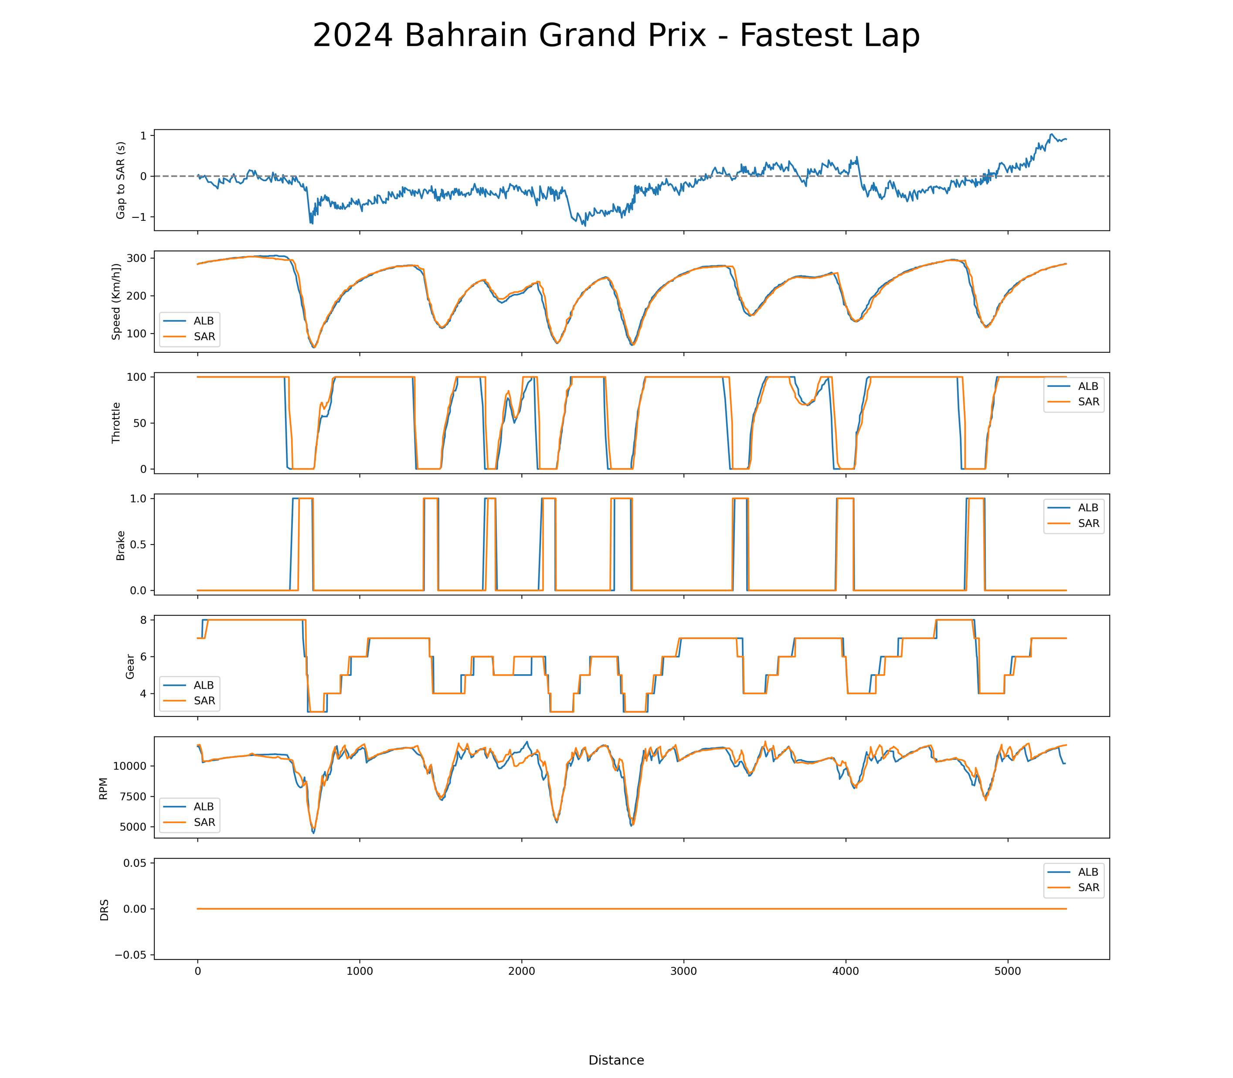
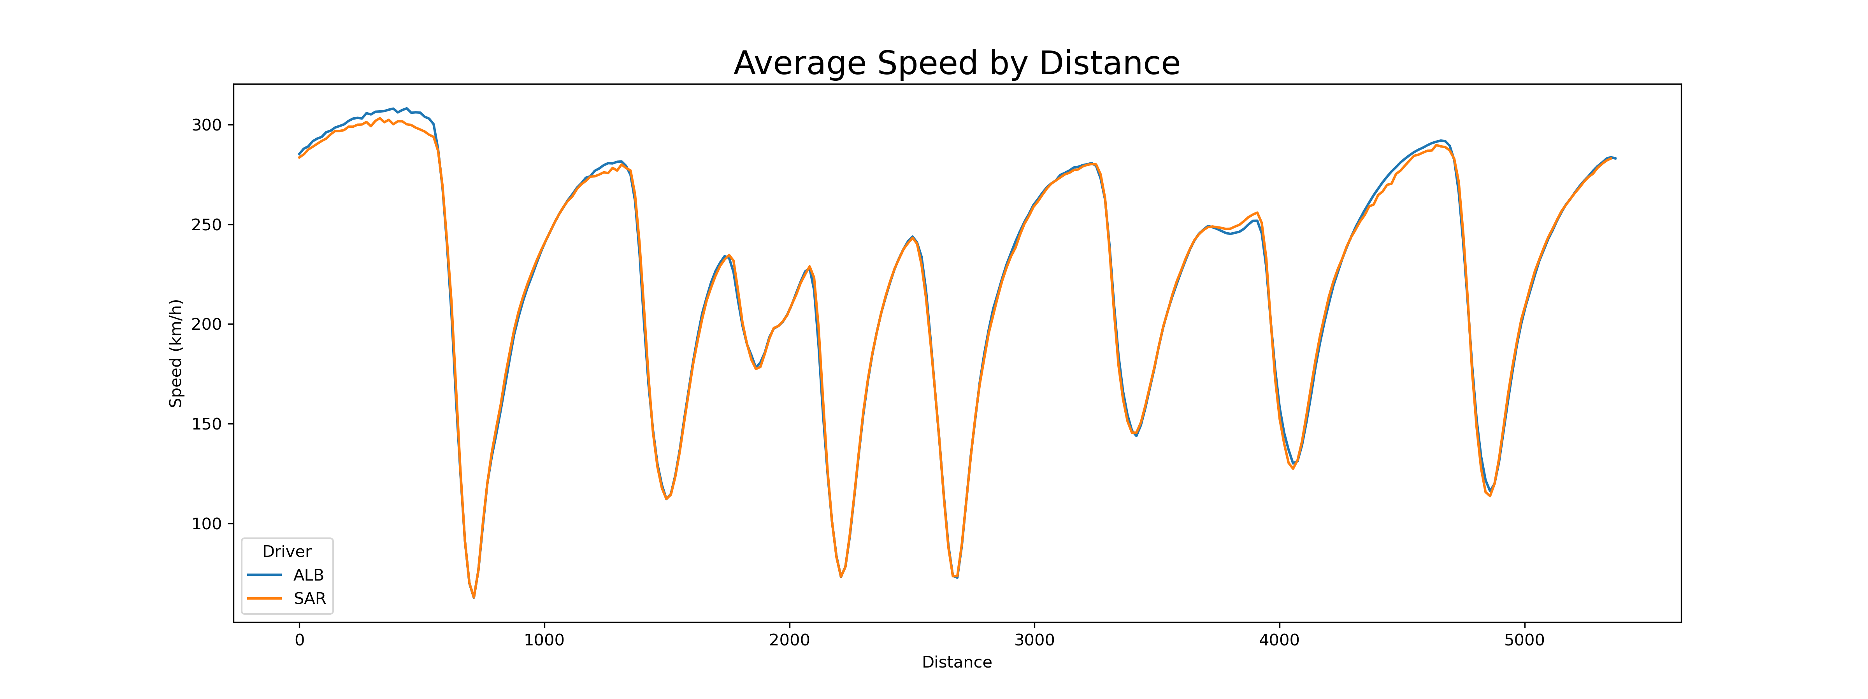
UBS
Player Performance
BAHRAIN
GRAND PRIX
CORNER performance
2 MARCH 2024

Slide 8
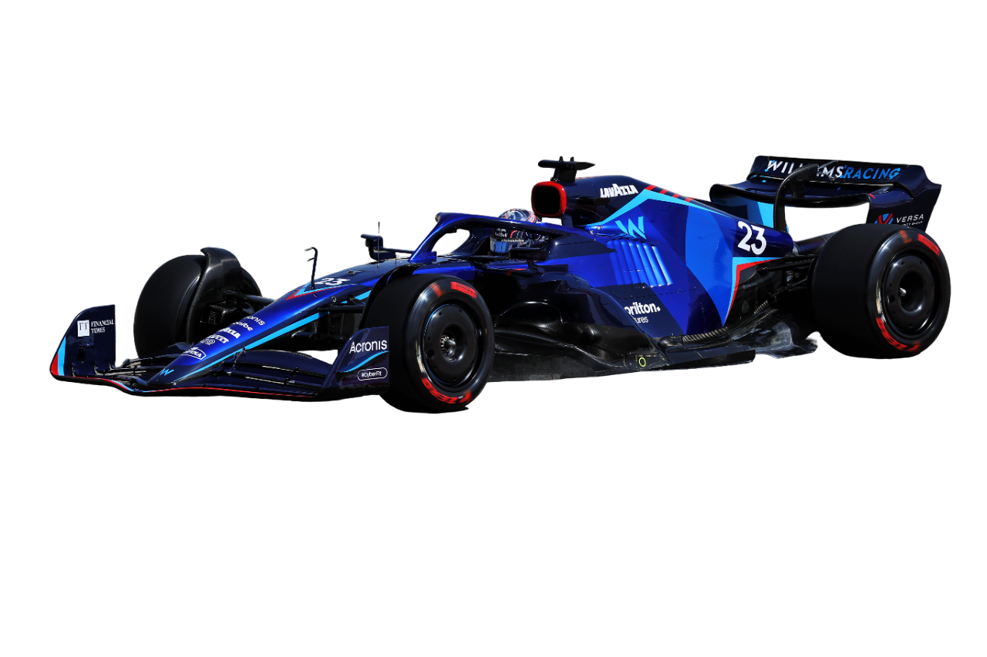
THANKS FOR LISTENING
UBS
BAHRAIN
GRAND PRIX
Sakheer الصخير‎
MSDM 5005 Group 4
2 MARCH 2024

